Slide 1
Docker-Compose MERN
REACT ( MERN ) TO DOCKER IN SIMPLE PROJECT

Slide 2
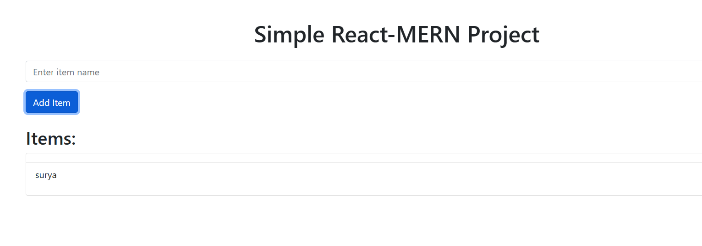
Docker compose
Stop 1
React install . Express js . mongoDB .Node.js
Build code and Design.
Project
Create to dockerfile

Slide 3
NODE.JS Create a server.js Connection the Mongoose
const express = require('express');
const mongoose = require('mongoose');
const cors = require('cors');
// Create express app
const app = express(); ➔ middleware create
const PORT = 5000;
// Middleware
app.use(cors());
app.use(express.json());
// Connect to MongoDB
mongoose.connect('mongodb://mongo:27017/mern-docker')
.then(() => console.log('Connected to MongoDB'))
.catch((err) => console.log(err));
// Item schema
const itemSchema = new mongoose.Schema({ ➔ store date my date
name: String,
});
const Item = mongoose.model('Item', itemSchema);
// GET endpoint to fetch all items
app.get('/api/items', async (req, res) => {
const items = await Item.find();
res.json(items);
});
// POST endpoint to create a new item
app.post('/api/items', async (req, res) => {
const newItem = new Item({ name: req.body.name });
await newItem.save();
res.json(newItem); ➔ New name olny store the date
});
// Start server
app.listen(PORT, () => {
console.log(`Backend running on http://localhost:${PORT}`);
});

Slide 4
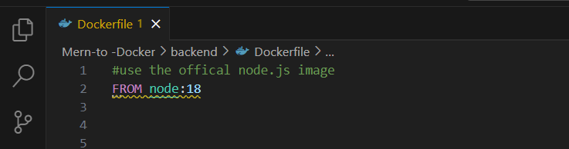
Code ➔ Backend
#use the offical node.js image
FROM node:18
#set the working directory in the container
WORKDIR /usr/src/app
#install dependencies
COPY package.json ./
RUN npm install
#Copy the rest of the application code
COPY . .
#Expose the backend port
EXPOSE 5000
CMD ["npm", "start"]

Slide 5
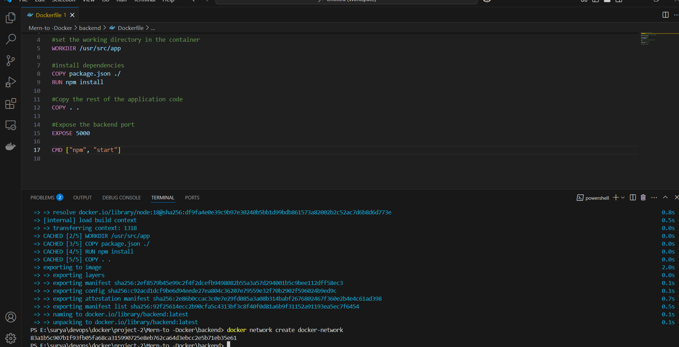
CMD
➔ .docker build -t backend
➔ docker run -p 5000:5000 backend
➔ docker network create docker-network
➔ docker run --name m-backend --network node-network -p 5000:5000 m- backend
➔ docker build -t m-backend .

Slide 6
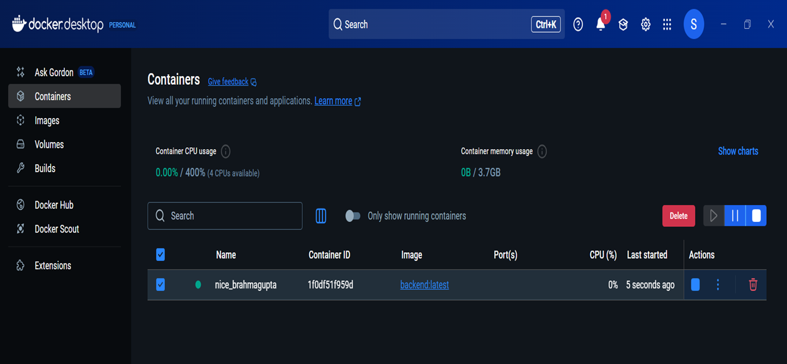
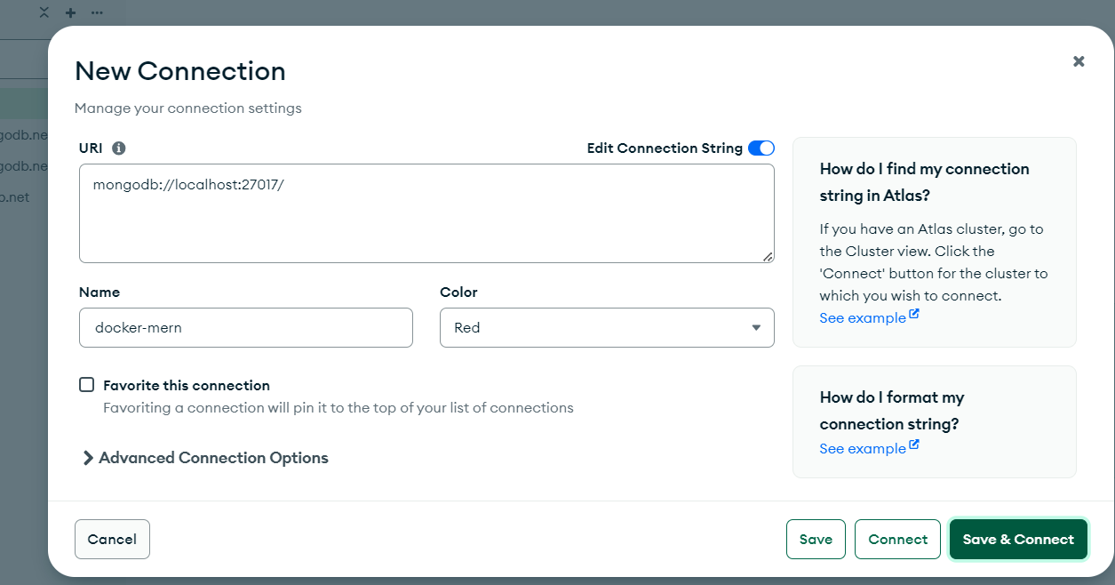
Stop ➔ 3
Mongodb Connections

Slide 7
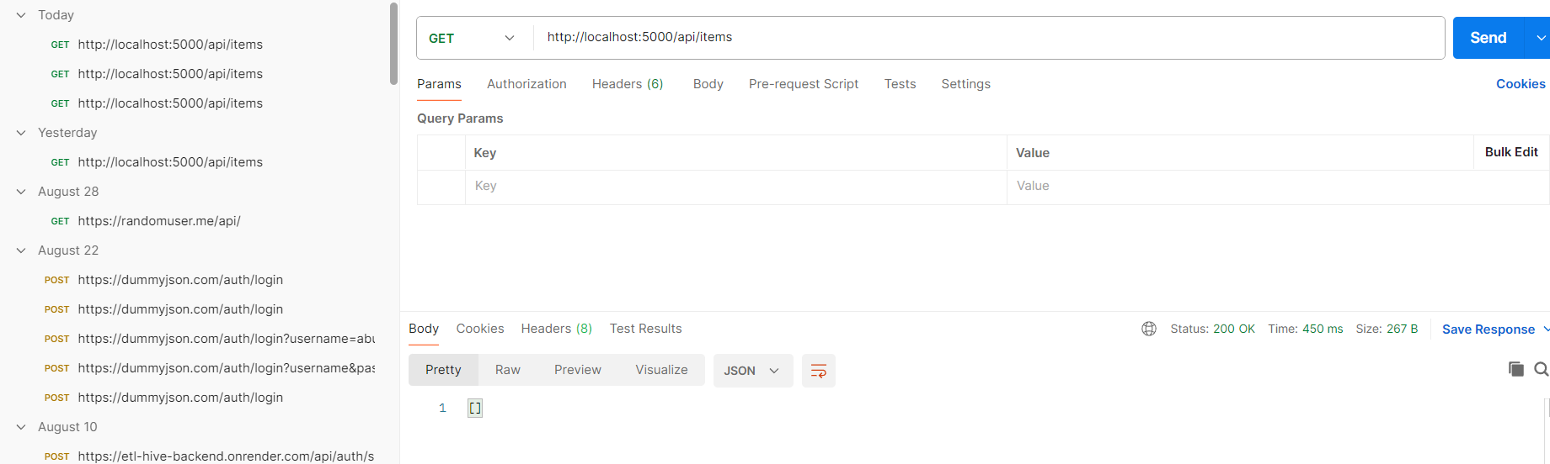
Stop➔ 4
Postman Connection
Docker network create

Slide 8
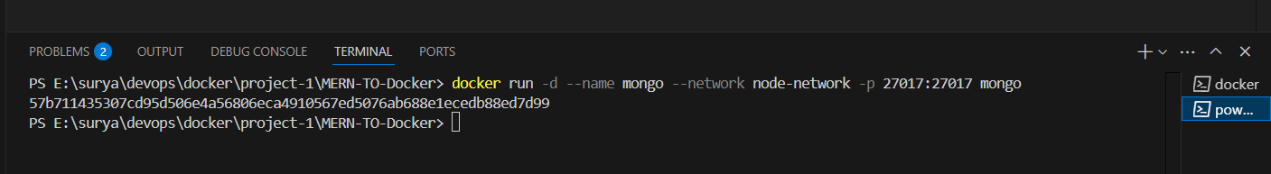
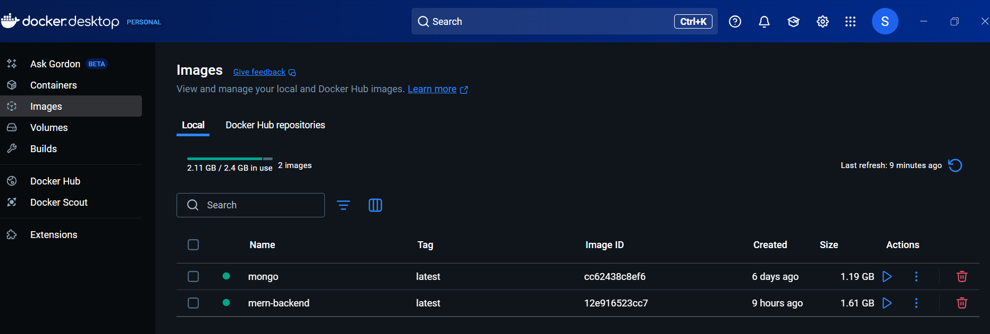
MongoDB Create
mongo backend
➔ docker run --name mongo -d -p 27017:27017 mongo
Stop ➔ 5

Slide 9
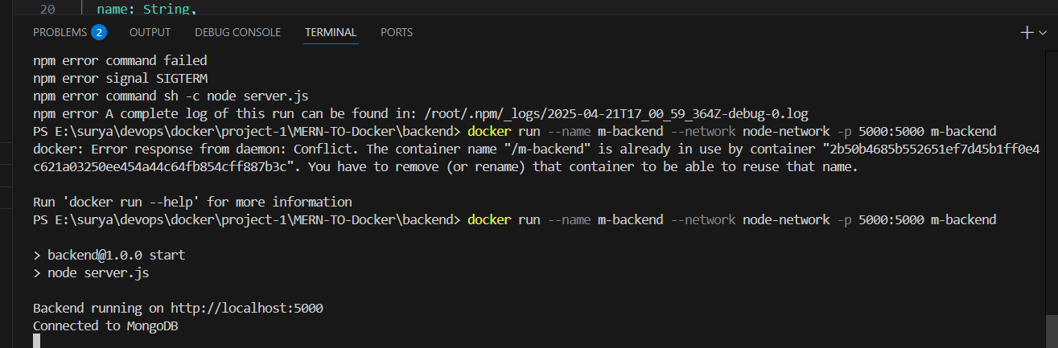
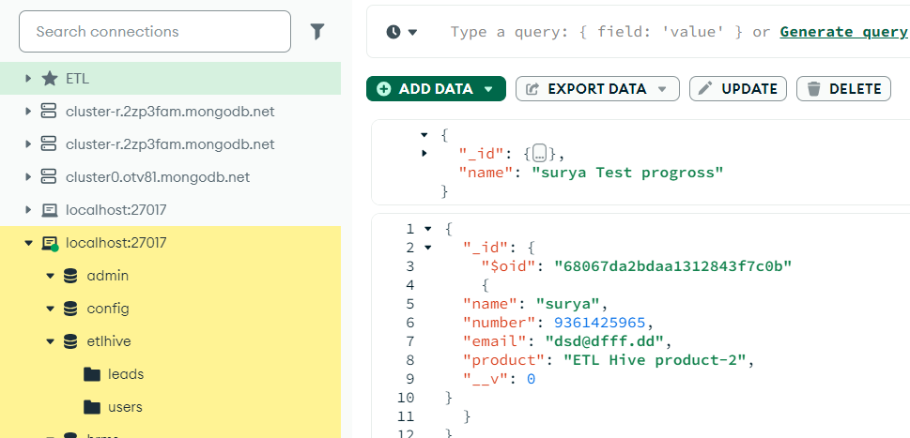
Node and MongoDB Connection
Backend running to http://localhost:5000/
MongoDB Insert Data

Slide 10
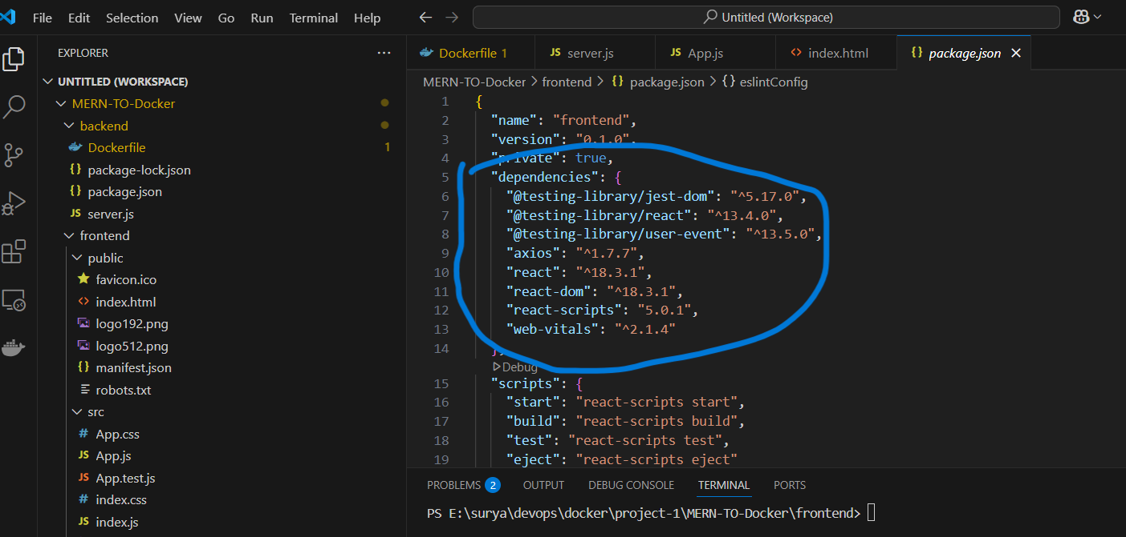
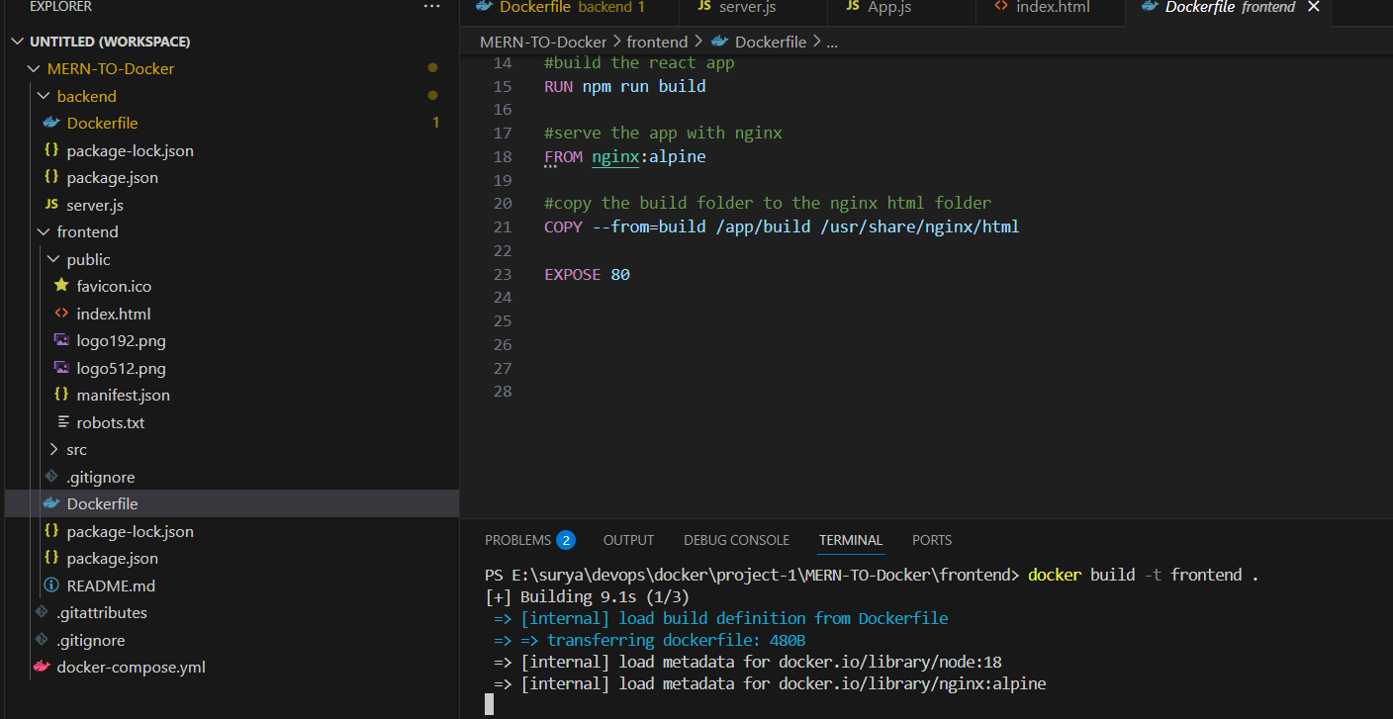
FRONTEND CONNECTION
PACKAGE.JSON ➔ Dependencies
Frontent Build the docker connection

Slide 11
CODE ➔ Frontend
#use the official nodejs image for build the react app
FROM node:18 AS build
#set working directory
WORKDIR /app
#copy the package.json and install dependencies
COPY package.json ./
RUN npm install
#copy the rest of the app code
COPY . .
#build the react app
RUN npm run build
#serve the app with nginx
FROM nginx:alpine
#copy the build folder to the nginx html folder
COPY --from=build /app/build /usr/share/nginx/html
EXPOSE 80
CMD
➔ docker build -t frontend .
➔ docker run --name frontend -p 8000:80 frontend

Slide 12
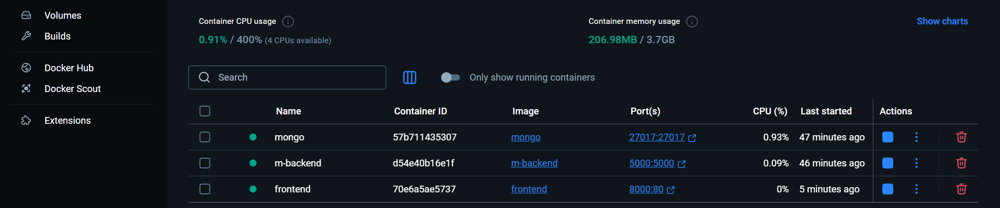
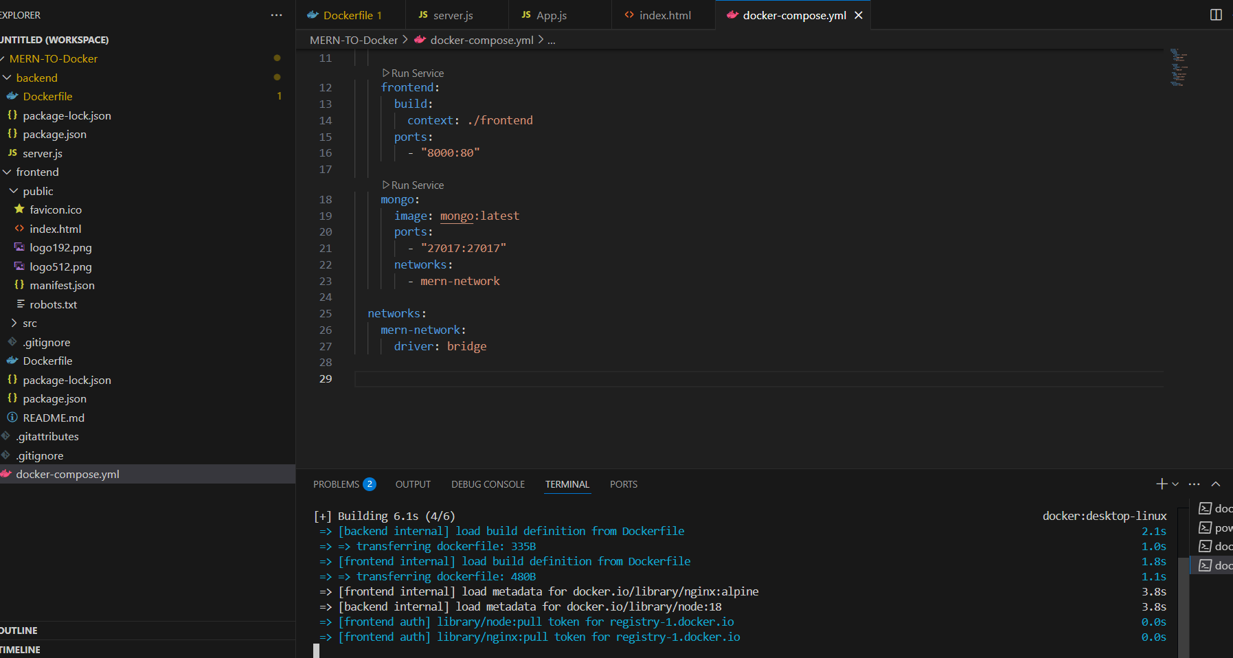
Frontend and Backend Create the Docker Engine Multiple componets
The Finaly Docker compose create the file

Slide 13
CODE ➔
version: '3'
services:
backend:
build:
context: ./backend
ports:
- "5000:5000"
networks:
- mern-network
frontend:
build:
context: ./frontend
ports:
- "8000:80"
mongo:
image: mongo:latest
ports:
- "27017:27017"
networks:
- mern-network
networks:
mern-network:
driver: bridge

Slide 14
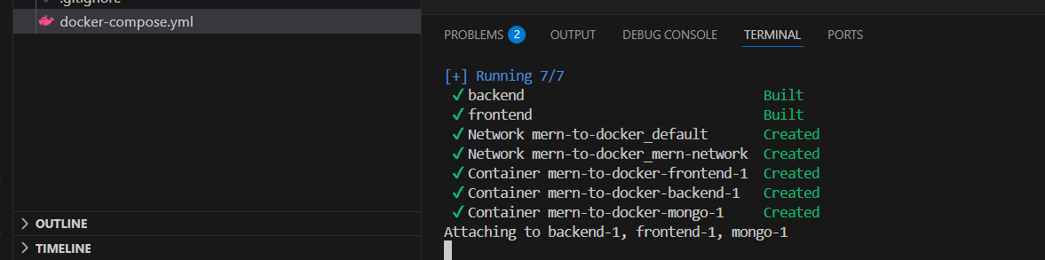
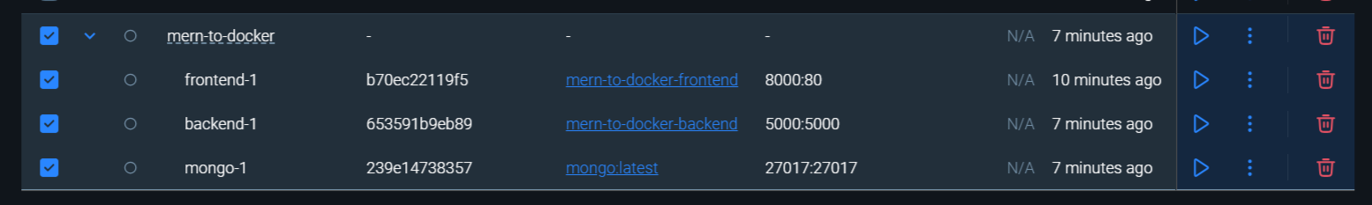
CMD
➔ docker-compose up
Frontend and Backend Create the Docker Engine Multiple Container TO Single Container Created

Slide 15
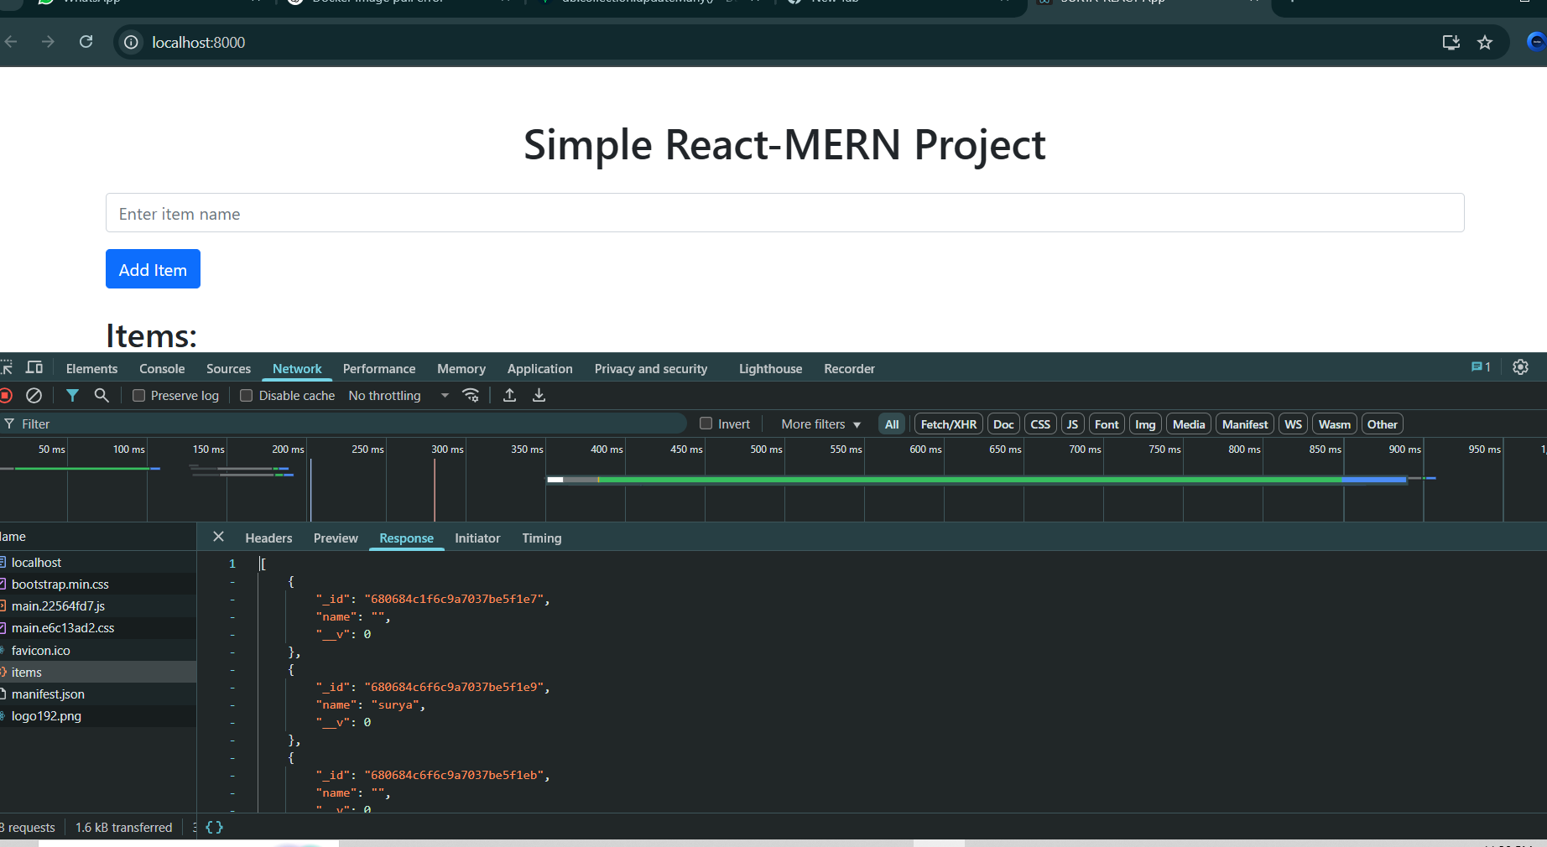
Simple React Use to MERN in backend API & Result

Slide 16
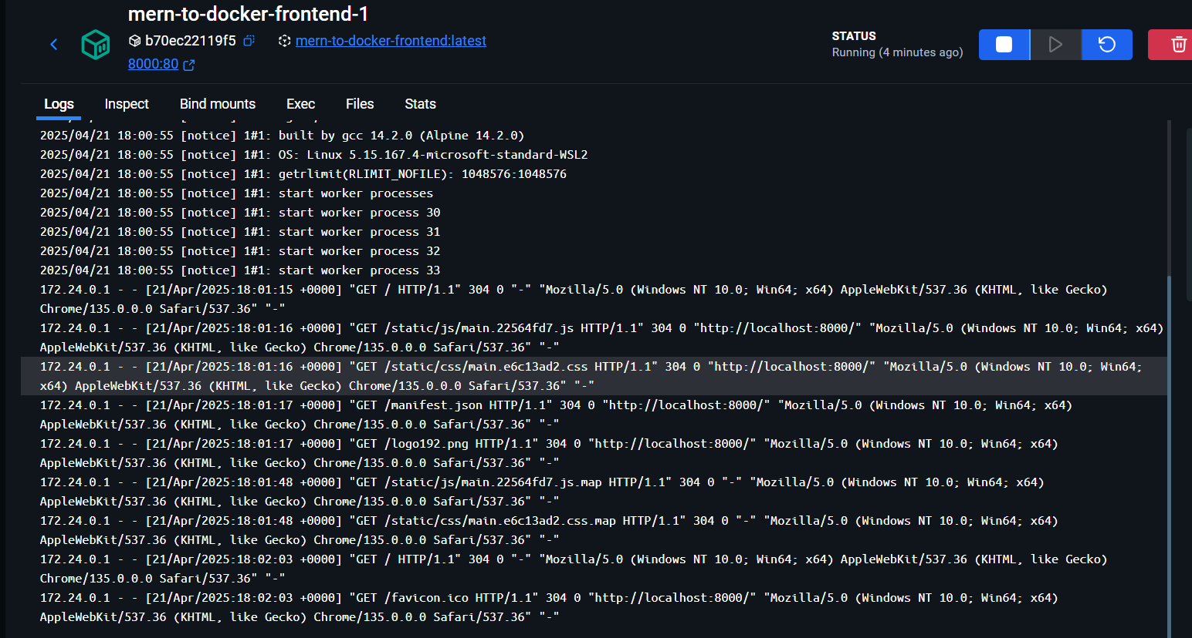
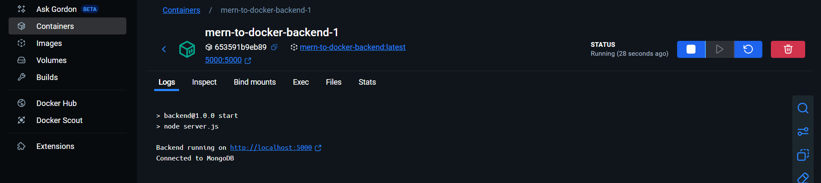
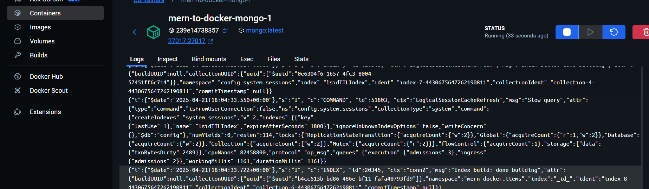
FRONTENT
BACKEND
MongoDB

Slide 17
THE END

